Slide 1

INFORMATION MANAGEMENT PRACTICES AND METHODOLOGIES IN ARCHITECTING INFORMATION SYSTEMS
Tatiana Orel
Inge Alberts, PhD
Mary Cavanagh, PhD
CAIS 2025
School of Information Studies
University of Ottawa, Canada
torel054@uottawa.ca
School of Information Studies
University of Ottawa, Canada
ialberts@uottawa.ca
School of Information Studies
University of Ottawa, Canada
mcavanag@uottawa.ca

Slide 2
outline
Statement of problem
Research objectives
Research questions
Methodology
Sampling and scope
Conceptual framework
Findings
Discussion
Limitations
Conclusion

Slide 3


Statement of problem
A significant decrease in information findability is due to
The exponential growth of information with evolving forms of records and formats;
Information decentralization (no single entity is the sole authority);
Less metadata creation.
Records management cannot adequately address all the phases of the information lifecycle;
Challenges with compliance and regulations are increasing.
Information Architecture for Information Management to Support Information Governance

Slide 4

Research objectives
Overview of the current trends in the field of IA for IM to support information professionals with a better understanding of:
IA concepts, practices, methods, and methodologies;
The required knowledge and skills to architect information systems.

Slide 5

Research questions
What are information architecture and its elements?
What methodologies, methods and practices do information professionals currently utilize to develop information architecture for information management?
What education, roles, responsibilities, knowledge and skills are expected from the information architect in the current job market?

Slide 6
Methodology
Content analysis within the framework of qualitative and quantitative research.
The qualitative approach based on induction and deduction prevails in the research process.
The identification of text themes that were used to categorize the purposive sampling to inform the research questions.
The quantitative approach, through the implementation of descriptive statistics, complements the qualitative analysis in the description of findings.
The median experience of the research participants;
Ordinal variables related to their formal and informal education, including percentage descriptions;
Frequency distributions of relevant IA phenomena.
Content Analysis
Qualitative Approach
Quantitative Approach

Slide 7


Sampling and Scope
The research included non-probabilistic purposive sampling. The data collection consisted of three major phases involving content analysis:
The analysis of 11 surveys of information professionals administered online by means of SurveyMonkey.
The results of these surveys were used as a ground for conducting 5 follow-up interviews guided by a list of open-ended questions reflecting key themes from the survey conducted via Zoom or MSN Teams.
The analysis of 50 job postings for information architects from the leading Web platforms, such as LinkedIn, Google Jobs, Monster, Quora and Indeed.

Slide 8
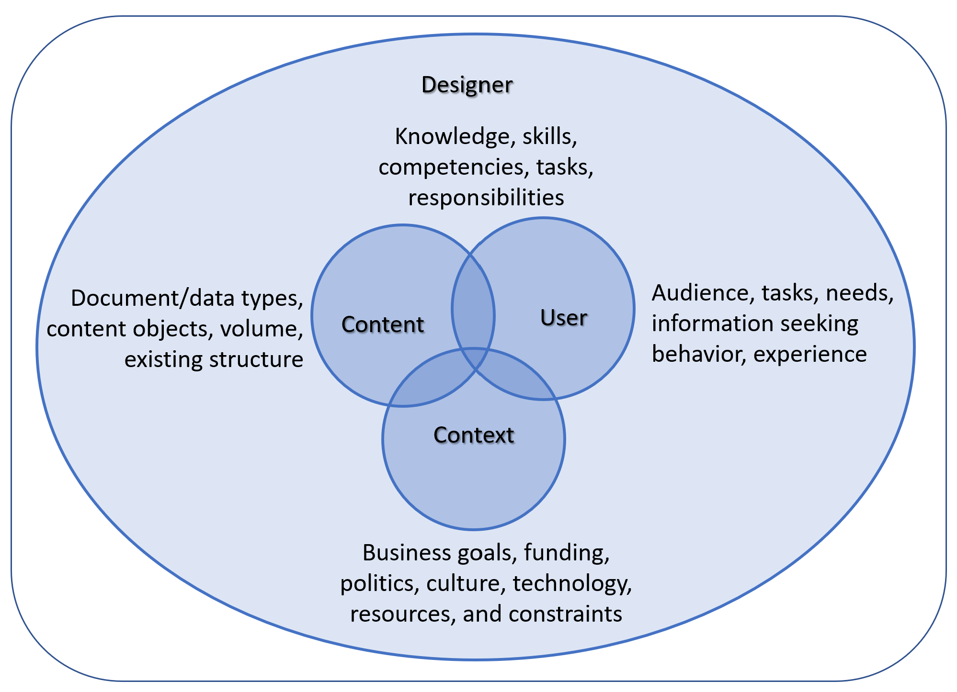
Conceptual framework (Morville & Rosenfeld, 2006)
Figure 1. Four Elements of IA (adapted from Morville & Rosenfeld, 2006, p. 41)

Slide 9
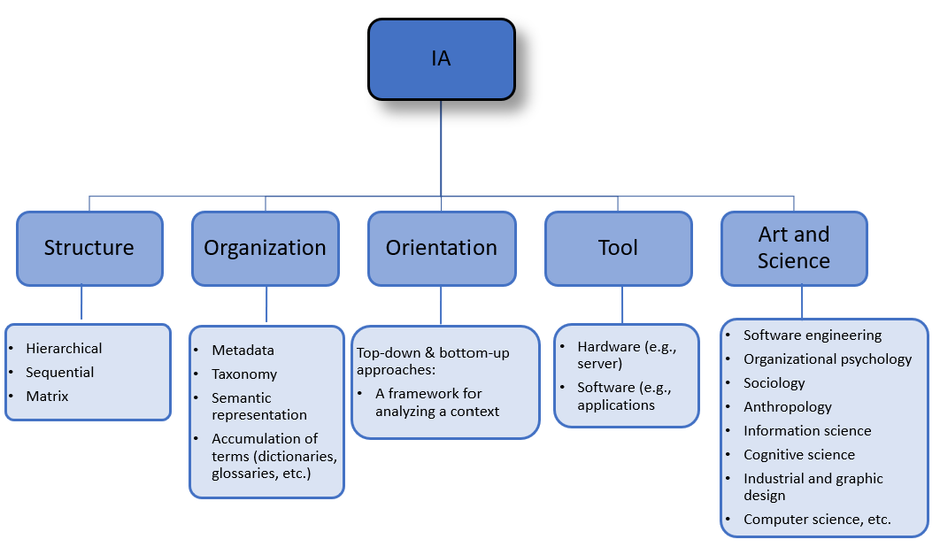
Findings: The concept of ia
Figure 2. The Concept of IA Based on the Aspects Discussed by Almeida et al. (2020) and Morville and Rosenfeld (2006) and Supported by the Data

Slide 10
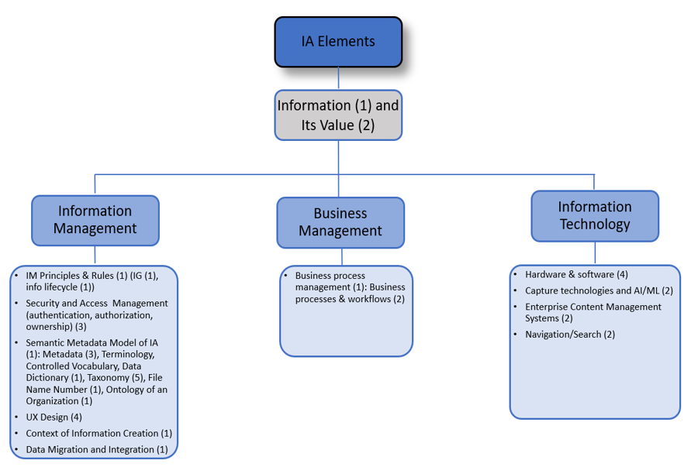
Findings: The elements of ia
Figure 3. The Elements of IA and Their Frequency in the Brackets Found in the Survey Data for the Category “Elements of IA” of the Coding Scheme

Slide 11
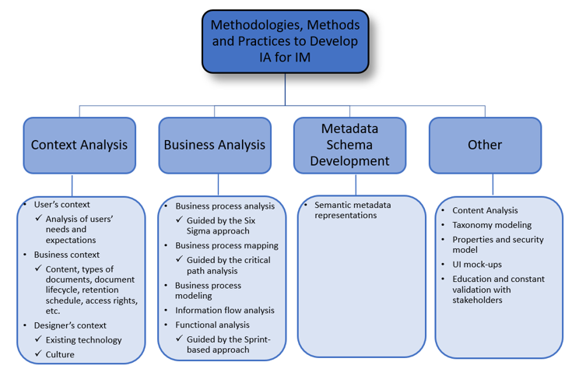
Findings: methodologies, Methods and practices to develop ia for im
Figure 4. Methodologies, Methods and Practices to Develop IA for IM Based on the Survey and Interview Data

Slide 12
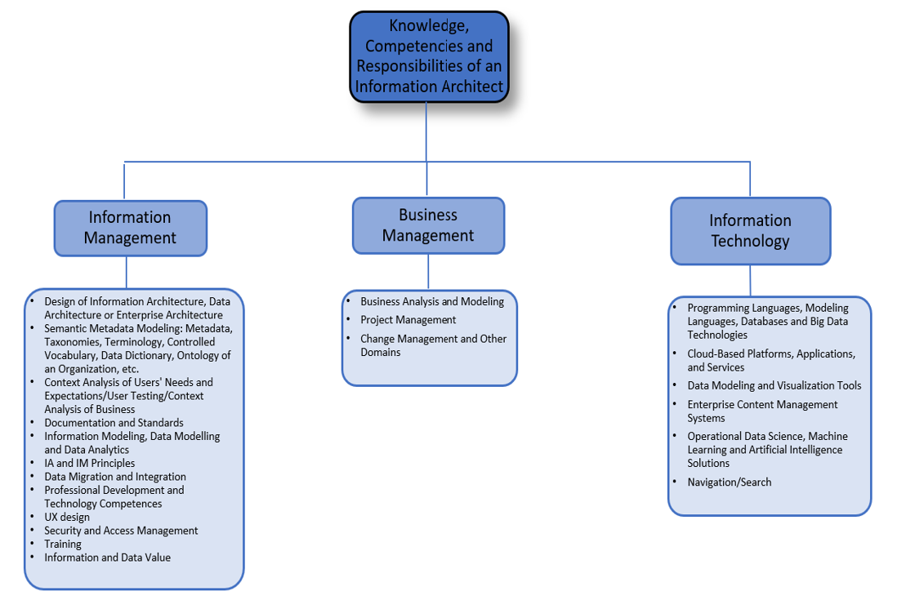
Findings: information architect: knowledge, competences and responsibilities
Figure 5. Knowledge, Competences and Responsibilities of an Information Architect

Slide 13
Findings: information architect: soft skills and personal qualities
Communication: Written and Verbal
Agility
Research, Analysis and Problem Solving
Mentoring
Collaboration and Teamwork
Attention to Detail and Pattern Recognition
Leadership
Sharing and Transparency
Interpersonal skills
Public Speaking/Presentation
Multitasking
Negotiation
Curiosity, Intellectual Rigor and Creativity
Complexity Tolerance
Business Acumen
Organization
Listening
Prioritization
Flexibility
Figure 6. Soft Skills and Personal Qualities Expected from an Information Architect

Slide 14
Discussion
All the methods and practices in the IA design found in the data are in line with the ones described in the literature review.
The concept of IA, its methodologies, methods and practices are not well-defined. Misconceptions were identified in the diverse spectrum of knowledge and experience expected from an information architect.
Already constructed or pre-made ontologies of some knowledge domains may support IA design.
The IT perspective in the IA design prevails over the IM perspective in the IA domain.

Slide 15
limitations
Generalizability
Small samples support the depth of qualitative research (Sandelowski, 1996).
Reproducibility
Reflexivity as an essential constituent of the immersion and crystallization methods was applied to data coding and analysis (Crabtree & Miller, 2023).
Subjects’ reactions and interactions in the process of scientific inquiries
E.g., unconscious reactions or working with classified information.
Snowball sampling
Effective in accessing hard-to-reach populations;
Well-suited for our exploratory research to understand nuanced perspectives within the specific community of information architects;
The triangulation technique was employed to enhance the diversity of the data by cross-verifying information from multiple sources.

Slide 16
Conclusion
This research provided an overview of the current trends in the field of IA for IM to support information professionals with a better understanding of its concepts, practices, and methodologies as well the required knowledge and skills to architect information systems.
The findings can be implemented to
Improve this emerging domain
Mitigate the fuzziness of its elements and methodologies
Provide some pedagogical implications to organize LIS programs and train potential stakeholders.

Slide 17
References
Almeida, M.B., Felipe, E.R., & Barcelos, R. (2020). Toward a document-centered ontological theory for information architecture in corporations. Journal of the Association for Information Science and Technology, 71(11), 1308–1326. https://doi.org/10.1002/asi.24337
Crabtree, B. F. & Miller, W. L. (2023). Doing qualitative research (Third edition.). SAGE Publications, Inc.
Morville, P., & Rosenfeld, L. (2006). Information architecture for the world-wide-web: Designing large scale web-sites (3rd ed.). Sebastopol, CA: O’Reilly Media.
Sandelowski M. (1996). One is the liveliest number: The case orientation of qualitative research. Res Nurs Health, 19(6): 525–9.

Slide 18

THANK YOU!
The image is generated by Gemini 2.5

